Slide 1

Git Remotes anywhere
Git Repositories anywhere
Terje Sandstrøm - May 2020
Notes:
Git is a distributed system, and there are no limits to the number of repositories you can have. Repositories can be combined, split, connected, and that in many ways.
This is an intrinsic feature of git.

Slide 2
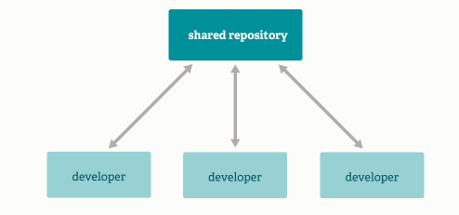
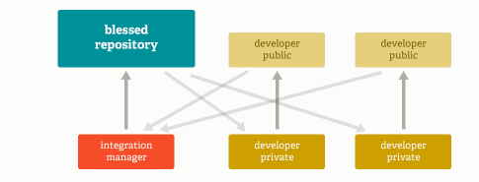
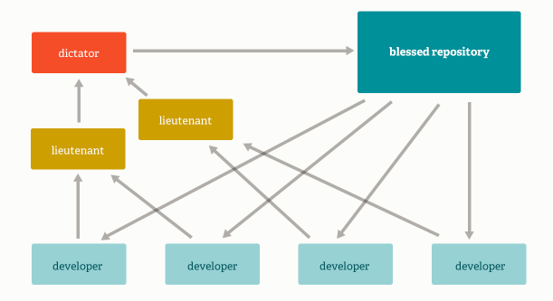
Repository models
Integration Manager Workflow
Aka Github-style, Open Source
Std
Massive Projects

Slide 3
Same Repo, but anywhere

Slide 4
A repo can be local or remote
But it really doesn’t matter, they are all the same
Notes:
It doesn’t matter if a repo is local or remote. It doesn’t matter if the implementations of the repo is filebase, database based, cloud, or whatever.

Slide 5
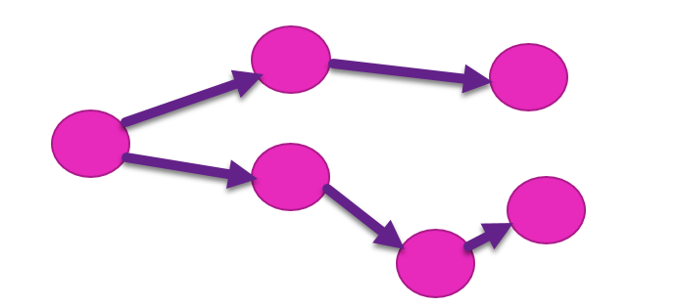
Same same, but different
The repos must have a commonality
The commonality normally start from a common ancestor, the first commit, that happened in a single repo.
After that, any diversity can happen
(As everything in git, even the statement above doesn’t really need to be true, but, for the normal case, it is better to think that way.)

Slide 6
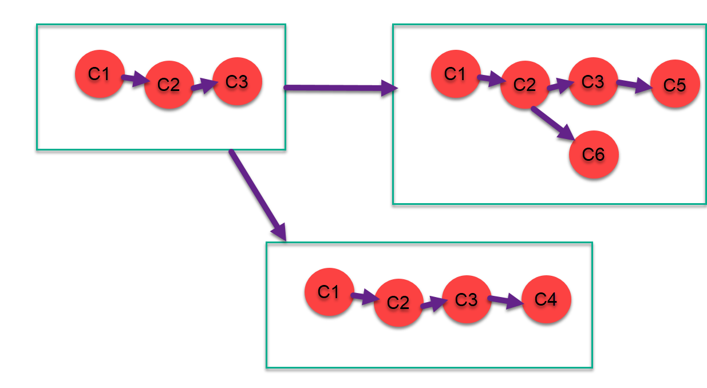
Define the truth, can you ?

Slide 7
Commits are immutable

Slide 8
Chaos
Git can handle chaos
We can’t

Slide 9
Creating order
Decide on ONE central repository, remote, as the final truth repository
Decide on the purpose for each remote repository
See models for large and massive systems

Slide 10
Exercise 7.1

Slide 11
Bare repositories
Bare repositories are a kind of server type of repos
Use them on file servers, or locally
Good for backup
Good for setting up temporary office (e.g. remote offline offices)

Slide 12
Handling branches with multiple remotes
A local branch can have only one upstream
Define a mandatory company convention for naming branches for multiple remotes
E.g. master-second, bmaster, masterb
Working with multiple remotes can be hard
Keep very good care of how you work

Slide 13
Exercise 7.2

Slide 14
Shallow clones
Can speed up CI builds
Might not always work
Try to shallow clone the linux repo…….
Always check if you achieve a performance boost
Don’t use for regular work
Commit/push may take much longer
You have no history….
And very few branches….
Don’t push this to a new remote…..
Notice shallow also means single-branch (you can override to a certain degree)
Convert back to regular using git fetch --unshallow

Slide 15
From Section 1: Exercise 1.2
Linux size is 2.75 GB
Openshift is 1.08 GB
VSCode is 275 MB
VS Code Python is 100 MB
NUnit3TestAdapter is 3.4 MB (with 8 years history)

Slide 16
Multiple workspaces for a single repo
Worktree command

Slide 17
Repo structures
One application – one repo
Look at versioning
If it versions together, keep them together
If not, keep them seperate
Define an internal repo structure convention
Code can be directly from root
Test projects may or may not be in a separate folder
If using VS, it may be easier to have them in parallel
Docs can go to the wiki, not the code repo
Readme contains developer information, and repo information

Slide 18
Managing a System with Git and Nuget
Split System into multiple Applications
Place each application in its own Git repository
Given they can have separate releases
Use a package manager to publish the binaries locally (within the company)
Use automatic package restore to retrieve them on build

Slide 19
MONOrepos
Pro:
Simplifies dependency management
Large scale refactoring
Unified versioning…. Sort of….
Con:
Require own tooling, e.g. Git VFS (supported by Azure DevOps, currently not by Github)
Complexity and rules to assure “things are done right”
Slow downloads
Tracking things down may be very cumbersome
Monorepos are not a fix for a lack of structure or a need to set up structure
Notes
Google uses its own server based implementation (see https://dl.acm.org/doi/10.1145/2854146 for more info)

Slide 20
MONO repos
Linux kernel:
Not a mono repo, but a mono tree
Notes
See https://blog.ffwll.ch/2017/08/github-why-cant-host-the-kernel.html

Slide 21
Subtrees and submodules
Avoid if you can. Use only when really needed!
Submodules are easier to push but harder to pull – This is because they are pointers to the original repository
Subtrees are easier to pull but harder to push – This is because they are copies of the original repository
Ref: https://codewinsarguments.co/2016/05/01/git-submodules-vs-git-subtrees/
https://www.atlassian.com/git/tutorials/git-subtree
https://stackoverflow.com/questions/31769820/differences-between-git-submodule-and-subtree

Slide 22
Useful tools
https://marketplace.visualstudio.com/items?itemName=OsirisTerje.IFix
Listgits: pip install listgits

Slide 23
Contact Terje Sandstrøm
Email: terje.sandstrom@solidify.se
Blog: http://hermit.no
Github: https://github.com/osiristerje
LinkedIn: https://www.linkedin.com/in/terjesandstrom/
Wiki for random git bits and pieces: https://terjesandstrom.github.io/git
Mob: +47-95750354

